Slide 1

Review that shows
its evidence
AGENTIC CODE REVIEW
We help reviewers catch AI-written software that looks right but isn't, by showing the evidence for every finding.
The ask: 6 teams for an 8-week pilot, from 1 January 2027
DEPI final pitch · draft 3 · logo is a prototype
Notes:
AI has made writing software fast, but checking it has not kept up. Where AI use is high, a review takes about five times as long. And the checking rests on very few people: in half of the ten public projects we measured, three people did more than 85% of all the reviewing. They are the bottleneck. We built a reviewer that shows its evidence, so they can check each finding instead of taking it on trust, and we are here to ask for pilot teams, not money.

Slide 2
Cheap to write.
Flawless to look at.
Five times as long to check.
Where AI use is high:
≈5×
+31%
as long to review a change
more changes go out with no review
Faros AI, 22,000 developers, via O'Reilly: review time +441.5%, unreviewed merges +31.3%. Vendor data; a link, not a cause.
Notes:
AI has made writing software cheap. What it produces looks flawless, like a report with perfect spelling and the wrong facts, so the people checking it can no longer tell where the problems are. The strain shows: where AI use is high, checking a change takes about five times as long, and nearly a third more changes go out with no check at all. These figures come from one vendor's study of 22,000 developers; they show a link, not a cause. If an example is asked for: one tech lead's first-hand account, of an AI-written change that used an old login system while every test passed and nothing in the change looked wrong. Three sources describe this kind of hidden mistake, and none measures how often it happens.

Slide 3
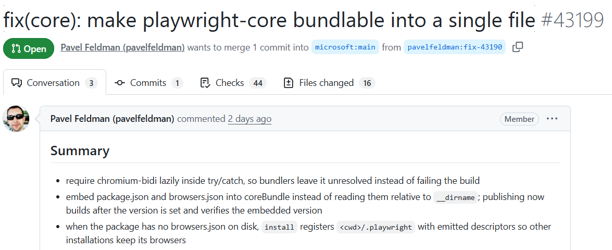

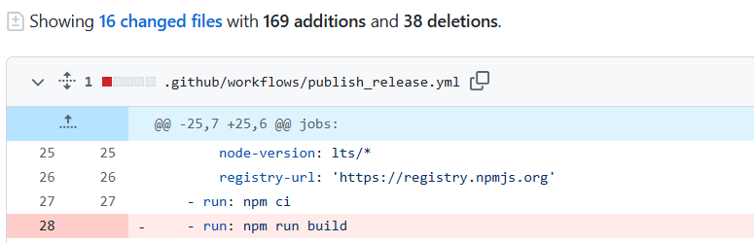

Every finding shows its evidence
$ agentic-review review --pr https://github.com/microsoft/playwright/pull/43199
INPUT · THE PULL REQUEST ON GITHUB
OUTPUT · WHAT THE TOOL REPORTED
16
files
10
reviewed
6
listed, not reviewed
nit
correctness
lines 49–53
evidence: diff hunk 1
packages/playwright-core/src/server/registry/index.ts
… calculateSha1(installationLinkTarget()) … will evaluate differently if process.cwd() differs between install and uninstall when bundled, leaving orphaned .links files.
Its own caveats. No checks were run and no related context was gathered in this build. No finding call named 9 of the 10 reviewed files.
Verdict: findings, none blocking
125.4 s, including the clone
Run 2026-10-09; the finding is unconfirmed by maintainers. Next: the project's own tests and rules as evidence (specified, not built).
Notes:
A developer runs one command and reads the findings. This is a real pull request on Microsoft's Playwright, open when it was reviewed and since closed without merging: one commit, 169 lines added and 38 removed across 16 files. The command read it from GitHub by its address and reviewed the ten TypeScript and JavaScript files in about two minutes, clone included, in one model pass. What you see is built: the finding carries its location, its severity and the part of the diff it rests on, and the review says what it did not do, here that no checks ran, no related context was gathered, and nine of the ten files got no finding call. Evidence from the project's own tests and type-check, and from the project's own rules, is specified and not built; nothing is posted on the pull request yet, which comes in version 3. We have not confirmed the finding with Playwright's maintainers. The run was made from the project notebook, which makes the same call as the command shown.

Slide 4
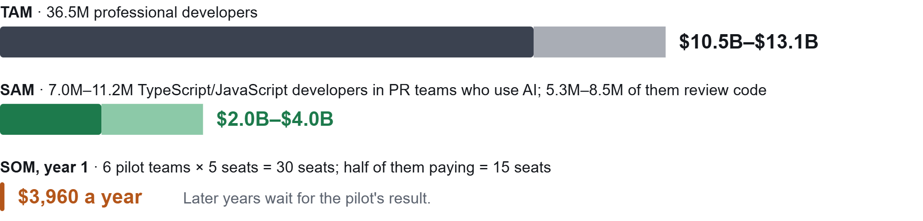
Up to $10.5B–$13.1B a year, at rivals' prices
Price used: rivals' entry price, $24–30 per developer per month. At our own price, $22 a seat, the TAM is $9.6B.
Sources: SlashData 2025; Stack Overflow 2019 and 2025; JetBrains 2025 (proxy). Figures are our calculations in the market study and the unit-economics file.
7M == 11.2M × 76.4% who say they review code as part of their work. = 5.3 - 8.5
Notes:
The ceiling assumes every professional developer pays rivals' entry price; narrowed to TypeScript or JavaScript developers in pull-request teams who use AI tools, it is $2.0B–$4.0B, and about three quarters of them review code, who are the people we serve. Our own price, $22 a seat, is set just under the cheaper of those rivals, so for us the same people come to $9.6B and $1.8B to $2.9B. What we can obtain is counted from the bottom up, from the only customers we can name: six pilot teams of five are 30 seats, and we assume half of them go on to pay, which is 15 seats, or $3,960 a year. Later years wait for the pilot's result, because we do not yet know how many seats really pay or how many more teams we can reach. For scale, the category leader reaches about 0.4% of professional developers, and no open-source review Action has passed 460 repositories.

Slide 5
Free CLI; hosted reviews at $22 a seat
FREE
PAID
Command-line tool
Hosted review service
Open source. Runs on the developer's own machine.
$22 per developer a month. Not designed yet.
CODERABBIT
GRAPHITE
OUR PRICE
OUR COST
$24
$20
$22
$1.14–$5.81
entry price, a seat a month
entry price, a seat a month
a seat a month
a seat a month, 25 to 75 reviews
Rivals' prices: vendors' pages. Our cost: the average seat's 25 to 75 reviews a month, at five to eight cents each from two measured runs; it doubles in 2027.
Notes:
The command-line tool stays free; the hosted service is priced at $22 per developer a month, the average of two rivals' entry prices and $2 under CodeRabbit's. Serving a seat is estimated to cost us $1.14 to $5.81 a month, which is 25 to 75 reviews at five to eight cents each in model tokens and repository downloads, and that estimate doubles in January 2027 with our provider's prices. The hosted service is not designed yet.

Slide 6
Built so far: a single-pass command-line review
✓ 2026-09-17
Reviews uncommitted changes in one model pass
✓ 2026-10-09
Reviews a public pull request by its address
Not built yet
Test runs, then a catch-rate benchmark
Source: git history. Build milestones, not traction.
Notes:
These are build milestones, not traction: the references record no user outside the team, no pilot and no letter of intent. On 2026-10-10 the first feature had 93 of its 127 tasks ticked, and we have measured review volume in ten public repositories and the cost of a review on two sizes of pull request. We cannot yet show that the tool catches code that does not fit its codebase, because the benchmark that measures a catch rate is not built.

Slide 7
Where we differ: nothing hidden, every gap reported
Tool | How a finding is checked | An unconfirmed finding | Entry price
CodeRabbit | Scripts and linters in a sandbox | Filtered out | $24 a seat a month
Greptile | Tests written and run in a sandbox | Not stated | $30 a seat a month
Qodo | A judge agent | Filtered out | Credit-based
Claude Code Review | A verification step | Filtered out | $15–25 a review
Agentic Code Review | One model pass; the project's own tests next (specified) | Kept, labelled "unverified" | $22 a seat a month
Sources: each vendor's own pages, read 2026-10-10. Rivals verify more than our build does today.
Notes:
Rivals verify more than our build does today: one writes and runs tests in a sandbox, another runs verification scripts, and ours makes one model pass. Our difference is narrower and it is built: a finding we cannot back is kept and labelled, where three of four rivals say they filter such findings out, and the review reports its own gaps. Price is a small difference, not the reason to choose us: $22 a seat is $2 under CodeRabbit, for a feature set of about its entry tier, a model that is likely noisier, and no measured catch rate.

Slide 8
Team members
Mohammed Gamal Kenawy
Mahmoud Ayman Mahmoud
Mohamed Ali Mahmoud
Team leader · Junior engineer
Junior software engineer
Senior Oracle developer
Ahmed Shahin
Abdelrahman Ehab
Yahia Ahmed Hamed
Sales manager
Junior software engineer
Junior software engineer
Notes:
We are four junior software engineers, a senior Oracle developer and a sales manager, and Mohammed Gamal Kenawy leads the team. If asked: the repository's history shows one author so far.

Slide 9
At $22 a seat, six seats cover fixed costs
A SEAT PAYS
A SEAT COSTS
A SEAT LEAVES
$22
$1.14–$5.81
$16–$21
a month, just under CodeRabbit's $24
a month, for 25 to 75 reviews
74% to 95% of the price
Fixed Costs - Always-on infrastructure: $96.36 a month, estimated
Covered by 5 to 6 seats
Costs: two measured runs, 25 to 75 reviews a seat, one assumed server; 2026 prices. Forecast: CodeRabbit's reported funding and Sacra's revenue estimates, at our price. We have no traction and have raised nothing.
Notes:
A seat brings in $22 a month and is estimated to cost $1.14 to $5.81 to serve, for an average of 25 to 75 reviews, so it leaves $16 to $21. The always-on infrastructure is estimated at $96.36 a month with one small server, which five to six seats cover; that says nothing about paying the people who build it. We have no traction, so the forecast is theoretical: it applies the category leader's capital efficiency to each million dollars invested. CodeRabbit had raised just under $20 million when its yearly revenue was about $1.8 million, at the end of its second year, and $88 million when it was $25 million, at the end of its third; the revenue figures are Sacra's estimates. At our price that is about 313 seats and $82,500 a year for each million by year 2, and 986 seats and $260,400 by year 3. We have raised nothing and ask only $300 to run the pilot, so this is a benchmark, not a plan. If asked about heavy users: a seat includes 150 reviews a month, pooled across the team, which costs us an estimated $17.90 at most.

Slide 10

We ask for $300 and six pilot teams
Six teams run it on their real changes for 8 weeks from 1 January 2027. By 28 February 2027: 1,000 reviews, with 20% of findings acted on.
REVIEWS
FIXED COSTS
RESERVE
TOTAL ASK
$80
$194
$26
$300
1,000 reviews × $0.08
2 months × $97 infrastructure
rounding $274 up to $300
for the whole pilot
The pilot turns our claims into measurements: pull requests per month, review time, current tools and spending, willingness to pay, and our own cost per review.
CONTACT
mohammedgamal2002@gmail.com · github.com/MoKenawy/Pull-request-Reviewer
Agentic Code Review · Review that shows its evidence
Notes:
We ask for $300 and six pilot teams. The teams run the tool on their real changes for eight weeks from 1 January 2027, and by 28 February 2027 we aim to have reviewed 1,000 pull requests, with reviewers acting on at least 20% of the findings; research puts that figure at 0.9% to 19.2% for AI review comments. The $300 covers the whole pilot: 1,000 reviews at about 8 cents each is $80, two months of always-on infrastructure at about $97 a month is $194, which makes $274; we round up to $300, leaving a $26 reserve. A pilot measures what our plan still leaves blank: pull requests per month, review time, current tools and spending, and willingness to pay, and it gives us our own cost per review from real changes. Repeat the ask in one sentence, then leave this slide on screen during questions.

